Slide 1
How to make and recognize a good espresso in 5 mins
WALTER WIMER HERNANDEZ

Slide 2
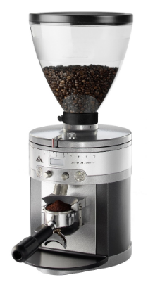
THE HEART OF THE COFFEE
A great espresso always starts here.
Freshly ground beans are the absolute foundation of a perfect cup. Never compromise on your grinder.

Slide 3




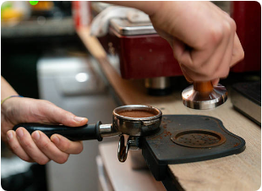
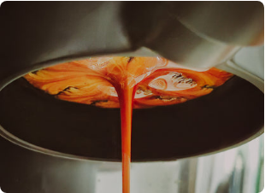
3 Steps to Perfection
1. Fresh Beans
2. Even Tamp
3. Extract
Use recently roasted beans. Weigh exactly 18g.
Level the grounds and press firmly for a flat puck.
Watch for a steady, thick flow like warm honey.

Slide 4
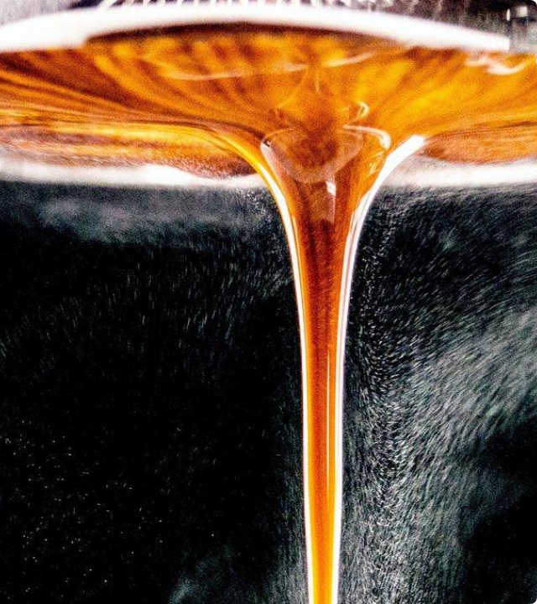
Dialing the Grind
The texture is everything.
Aim for a consistency similar to fine table salt. This provides the exact resistance needed for a perfect 25-30 second extraction.

Slide 5

Recognizing Quality
A rich, hazelnut-colored crema is the signature of a perfect espresso. It traps the aromas and coats the palate.

Slide 6






Image Sources
https://graef-global.com/media/thumbs/63/79/888702b875290ec42dd12dad21f7f419fc61/1400x_crop=center;format=webp/managed/34/c6/34c615b540ed4ab1eb34c6bc4ffb50e9/GRAEF_Kaffeemuehle_CM8011_On-Demand-Funktion.jpg.thumb.webp
Source: graef-global.com
https://png.pngtree.com/png-vector/20241204/ourlarge/pngtree-falling-a-few-fresh-coffee-beans-on-transparent-background-png-image_14576826.png
Source: pngtree.com
https://media.istockphoto.com/id/2257617499/photo/close-up-of-professional-coffee-tamping-process-in-a-cafe.jpg?s=612x612&w=0&k=20&c=NBV_GAendO5_TIzOzuiWR_ur8gKhLmUT-m9bsZl9JIA=
Source: www.istockphoto.com
https://hypergrindcoffee.com.au/cdn/shop/files/Hypergrind-Black-Bottomless-Portafilter.jpg?v=1742388533&width=416
Source: hypergrindcoffee.com.au
http://ironbeancoffee.com/cdn/shop/articles/how-to-make-a-great-espresso-at-home-without-an-espresso-machine-iron-bean-coffee-company_b6644e13-51bb-4ff2-bc88-4eddbf952cbf.jpg?v=1764133885
Source: ironbeancoffee.com
https://twochimpscoffee.com/wp-content/uploads/2023/01/perfect-crema-2-scaled.jpg
Source: twochimpscoffee.com

